Slide 1


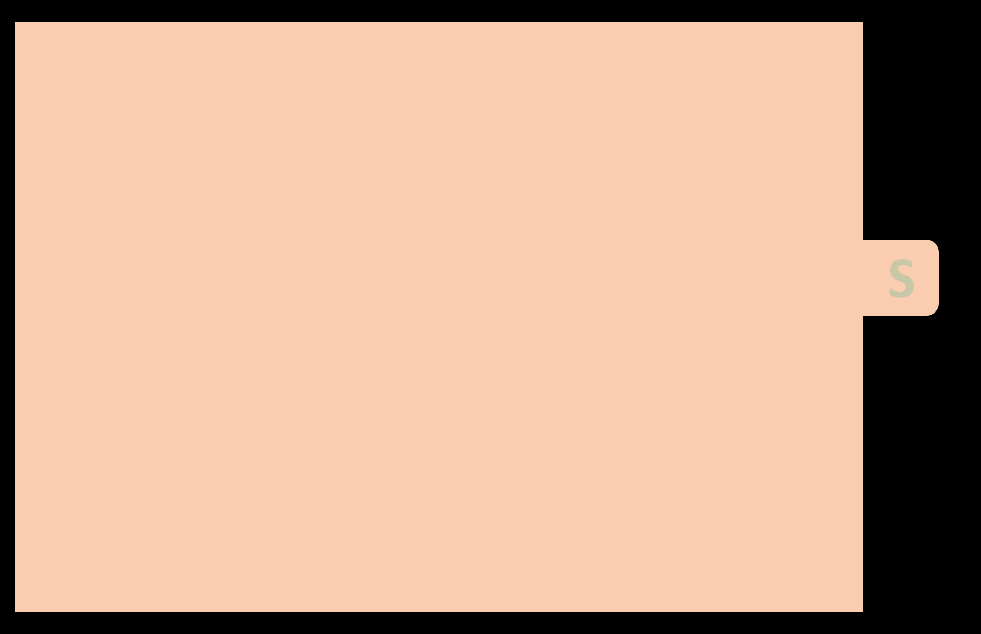
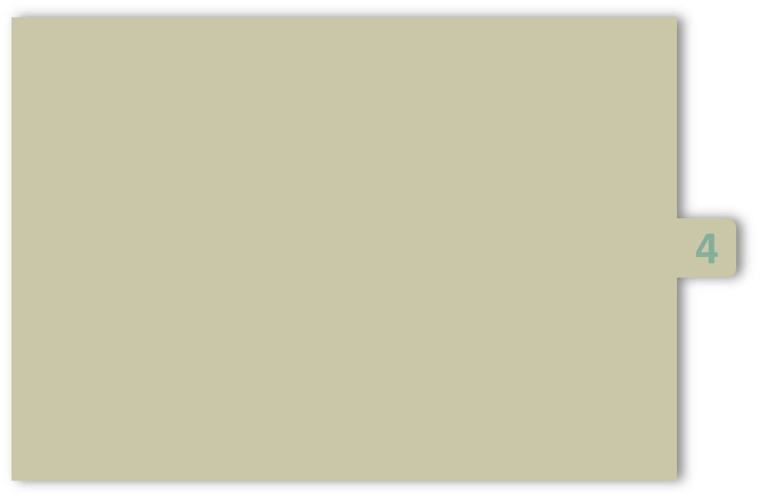
UNIT-4
Functions:
        Functions Definitions
        Declaration
        Types of Functions
        Parameter passing
        Recursion
        Passing Arrays to functions
        library functions
        functions and pointers
        Storage classes

Slide 2
Functions
Definition :
Function is a group of statements that together perform a task.
Every C program has at least one function, which is main( ), and all the complex programs can define additional functions.
You can divide up your code into separate functions. How you divide up your code among different functions is up to you.
A function is known with various names like a method or a sub-routine or a procedure, etc

Slide 3
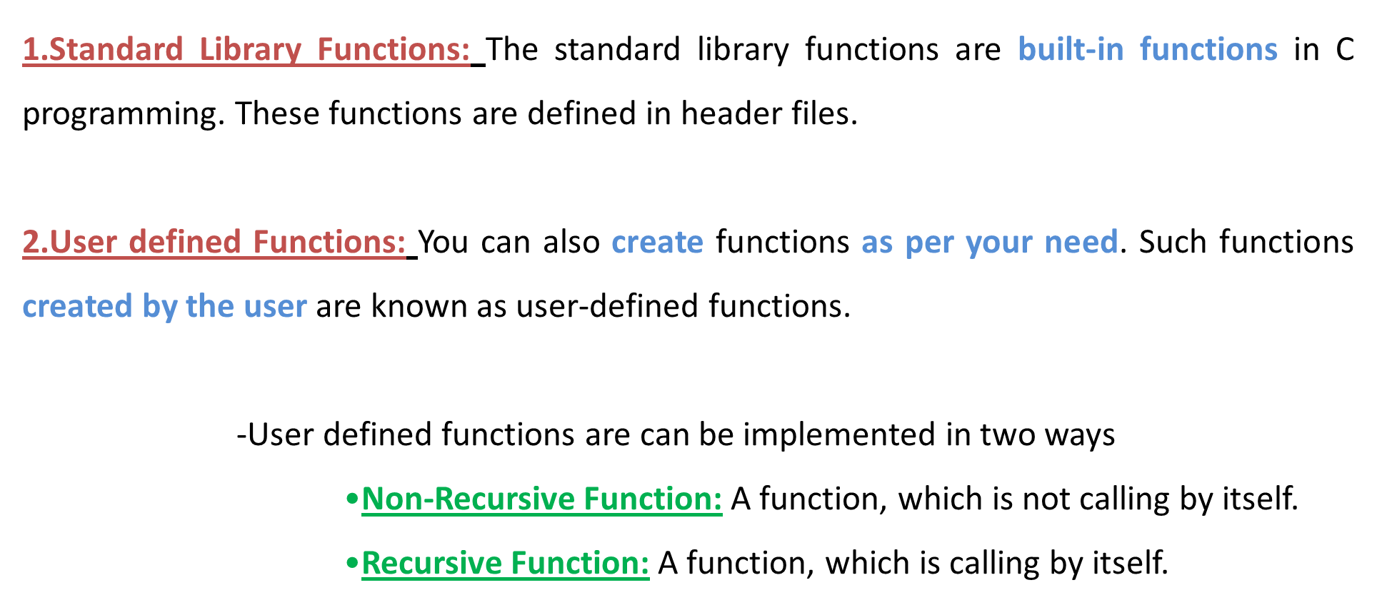
Types of functions

Slide 4
1.Standard Library Functions
C Library functions are inbuilt functions in C programming.
If you want to use the sqrt() function, the header file <math.h> should be included.
If you try to use sqrt( ) without including the math.h header file, you will get an error.
#include <stdio.h>
int main()
{
printf("%d", sqrt(4) );
return 0;
}

Slide 5
2.User defined functions
You can also create functions as per your need. Such functions created by the user are known as user-defined functions.
User defined functions are can be implemented in two ways
      Non-Recursive Function: A function, which is not calling by itself.
      Recursive Function: A function, which is calling by itself.
We need to declare a variable, before going to access it. As usual, before going to access a function we should do the following:
Function declaration
Function calling
Function definition (Function implementation)

Slide 6
a)Declaration of Function
A function declaration tells the compiler about a function's name, return type, and parameters and how to call the function.
Functions should declare at declaration part. i.e. after header files before main( ).
Example: int max(int num1, int num2); (or) int max (int, int);
Note: Parameter names are not important in function declaration. only their type is required.
Syntax: return_type function_name( parameter list );

Slide 7
b)Defining a Function
A function definition provides the actual body of the function.
The general form of a function definition in C programming language is as follows:
void main( ) { … } | return_type function_name ( parameter list ) { body of the function } | int sum( int a, int b) { return a+b; }
A function definition in C programming language consists of a function header and a function body. Here are all the parts of a function:

Slide 8
Return Type:
A function may return a value. The return_type is the data type of the value the function returns.
Some functions perform the desired operations without returning a value. In this case, the return_type is the keyword void.
Function Name:
This is the actual name of the function.

Slide 9
Parameters:
When a function is calling, you may pass a values.
This value is referred to as actual parameter.
The parameter list refers to the type, order, and number of the parameters of a function.
Parameters are optional
Function Body:
The function body contains a collection of statements that define what the function does.

Slide 10
c)Calling a Function
To use a function, you have to call that function to perform the task.
When a program calls a function, program control is transferred to the called function.
A called function performs task and it returns back to the main program.
To call a function, you simply need to pass the required parameters along with function name.
If function returns a value, then you can store returned value.

Slide 11
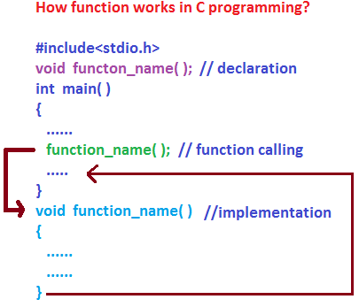

Slide 12
For example: #include <stdio.h> int max( int, int ); /* function declaration */ int main( ) { int a = 100, b = 200, ret; ret = max(a, b); /* calling a function. Here a, b are actual parameters */ printf( "Max value is : %d\n", ret ); return 0; } int max(int num1, int num2) /* Here num1, num2 are formal parameters */ { if (num1 > num2) return num1; else return num2; } Output: Max value is : 200

Slide 13
Forms of user defined functions
Functions can be classified into the following types:
      No return type with no parameters
      No return type with parameters
      Return type with no parameters
      Return type with parameters

Slide 14
No return type with no parameters | 2. No return type with parameters
#include<stdio.h> void sum( ); void main( ) { clrscr( ); sum( ); getch( ); } void sum( ) { int a=2, b=4, c; c = a + b; printf(“Total : %d”, c); } Output: Total : 6 | #include<stdio.h> void sum( int, int ); void main( ) { int a=2, b=4; clrscr( ); sum(a,b); getch( ); } void sum( int x, int y ) { int z = x + y; printf(“Total : %d”, z); } Output: Total : 6

Slide 15
3.Return type with no parameters | 4.Return type with parameters
#include<stdio.h> int sum( ); void main( ) { int x; clrscr( ); x=sum( ); printf(“Total : %d”, x); getch( ); } int sum( ) { int a=2, b=4; return a+b; } Output: Total : 6 | #include<stdio.h> int sum( int, int ); void main( ) { int a=2, b=4, c; clrscr( ); c=sum(a,b); printf(“Total : %d”, c); getch( ); } int sum(int x, int y) { int z = x+y; return z; } Output: Total : 6

Slide 16
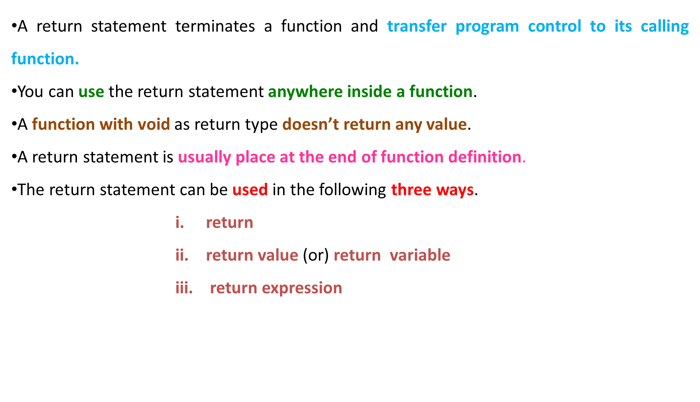
Return Statement

Slide 17
Return Statement
1)return:
  It is used to terminate the function and pass the control to the calling function.
  No value is returned from the called function .
  Ex: return ;
2)return value; (or) return variable:
  It is used to returns a value to calling function.
  It returns a value which is stored in variable.
  Ex: return 10 ;
3) return expression:
  It returns expression value .
  Ex: return a+b*10;
Syntax:
return ;
Syntax:
return variable;
Syntax:
return expression;

Slide 18
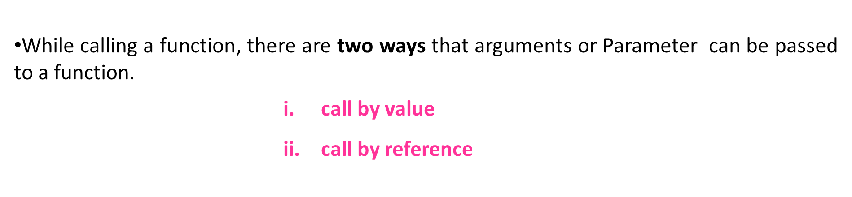
Parameter passing Methods

Slide 19
call by value
The call by value method ,we are passing duplicate copies from calling function to called function.
In this case, any changes made inside the called function have no effect on the argument in calling function.

Slide 20
Let us call the function swap() by passing actual values as in the following example: #include <stdio.h> void swap(int, int); /* function declaration */ int main( ) { int a = 100, b = 200; /* local variable definition */ printf("Before swap, value of a : %d, b: %d\n", a,b ); swap(a, b); /* calling a function to swap the values */ printf("After swap, value of a : %d, b: %d\n", a,b ); return 0; } void swap( int x, int y ) { int temp; temp = x; x = y; y = temp; } Output: Before swap, value of a :100, b :200 After swap, value of a :100, b :200

Slide 21
call by reference
The call by reference method, we are passing address from calling function to called function.
Inside the function, the address is used to access the argument/parameters.
This means that changes made in the called function will affect the calling function.

Slide 22
Let us call the function swap() by passing values by reference as in the following example: #include <stdio.h> void swap(int *x, int *y); /* function declaration */ int main( ) { int a = 100, b = 200; /* local variable definition */ printf("Before swap, value of a : %d, b : %d\n", a,b ); swap(&a, &b); /* addresses of a and b */ printf("After swap, value of a : %d, b : %d\n", a,b ); return 0; } void swap(int *x, int *y) { int temp; temp = *x; *x = *y; *y = temp; } Output: Before swap, value of a :100, b : 200 After swap, value of a : 200, b : 100

Slide 23
Recursion
“Recursion is a repetitive process in which an algorithm calls itself”.
“Recursion is a method, calling by itself”.
Example: void main( )
{
printf(“A simple recursive program”);
main( ); //recursive function
}

Slide 24
Design Methodology of Recursive algorithms
Every Recursive algorithm must have a base case and general case.
First, determine the base case.
Then determine the general case(recursive case).
Combine the base case and general case into an algorithm.
Base case: It is the condition where the recursion process stops.
General case (recursive case): It reduces the size of the problem.
When we are combining these two cases, we must pay careful attention to the logic. When the base case reached, it must execute a return.

Slide 25
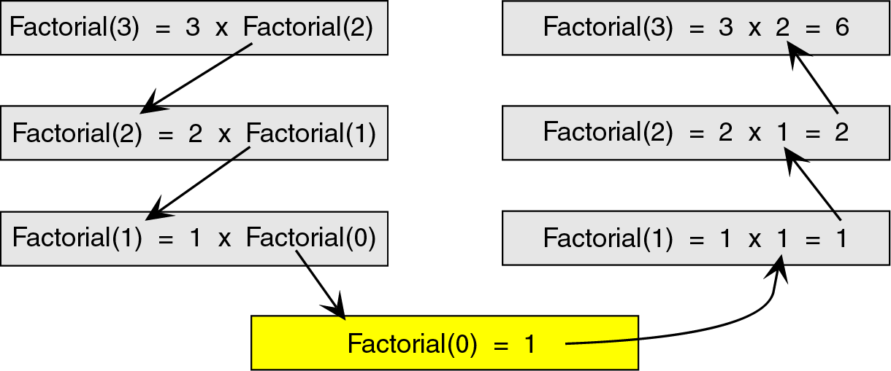
The recursive solution for a problem involves a two way journey.
First we decompose the problem from top to bottom, and then we solve it from the bottom to top.
The decomposition of factorial (3) is as follows:

Slide 26
int factorial(int n) { if(n==0 || n==1) // base case: gives solution some part of the problem return n; else return n*factorial(n-1) ; // general case: minimizing the code }

Slide 27
Non recursive program for factorial | Recursive program for factorial
#include<stdio.h> int factorial (int); void main() { int a , fact; clrscr(); printf("Enter a Integer value: "); scanf("%d", &a); fact = factorial(a); printf("Factorial value = %d", fact); getch(); } int factorial (int x) { int f=1, i; for(i=x; i>=1; i--) f = f * i; return (f); } | #include<stdio.h> int fact(int); main() { int result, n; clrscr(); printf("Enter a Integer value: "); scanf("%d", &n); result = fact (n); printf("Factorial value = %d", result); getch(); } int fact(int f) { if(f==0) return 1; else return f * fact(f-1); }

Slide 28
Passing Arrays to functions
If you want to pass a single-dimension array as an argument in a function you may use the following three ways
Way -1 | Way-2 | Way-3
Formal parameters as a sized array | Formal parameters as an unsized array | Formal parameters as a pointer
#include<stdio.h> void sum( int [] ); void main() { int a[10]; sum(a); } void sum ( int a[10] ) { … } | #include<stdio.h> void sum( int [] ); void main() { int a[10]; sum(a); } void sum( int a[] ) { … } | #include<stdio.h> void sum( int * ); void main() { int a[10]; sum(&a); } void sum(int *b) { … }

Slide 29
Storage Classes in C
A storage class is used to describe the following things about the variable:
        The variable scope.
        The location where the variable will be stored in a computer.
        The default initial value of a variable.
        A lifetime of a variable.

Slide 30
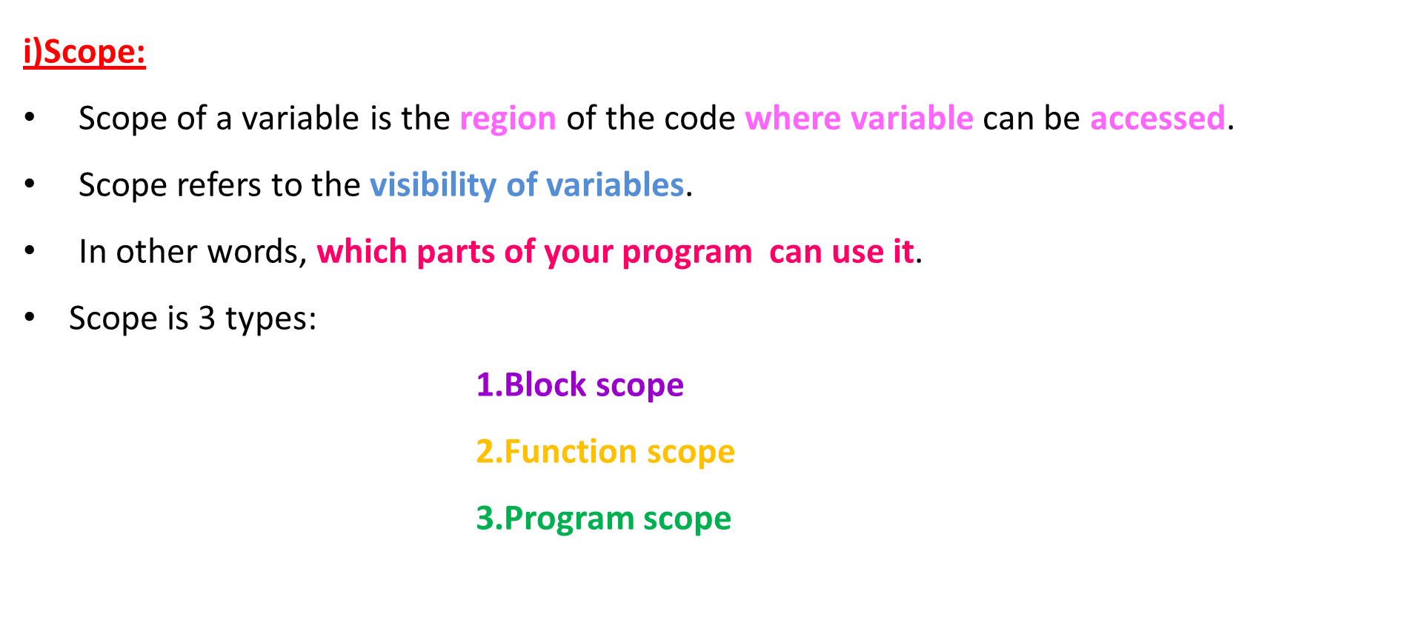
Storage Classes in C

Slide 31
Storage Classes in C
ii)Lifetime:
Lifetime of a variable is the time period for which the value of the variable is valid.
The lifetime of a variable is the time duration for which memory is allocated to store it, and when that memory is released.
Simply, how long a value of a variable is existed in compute memory during program execution.

Slide 32
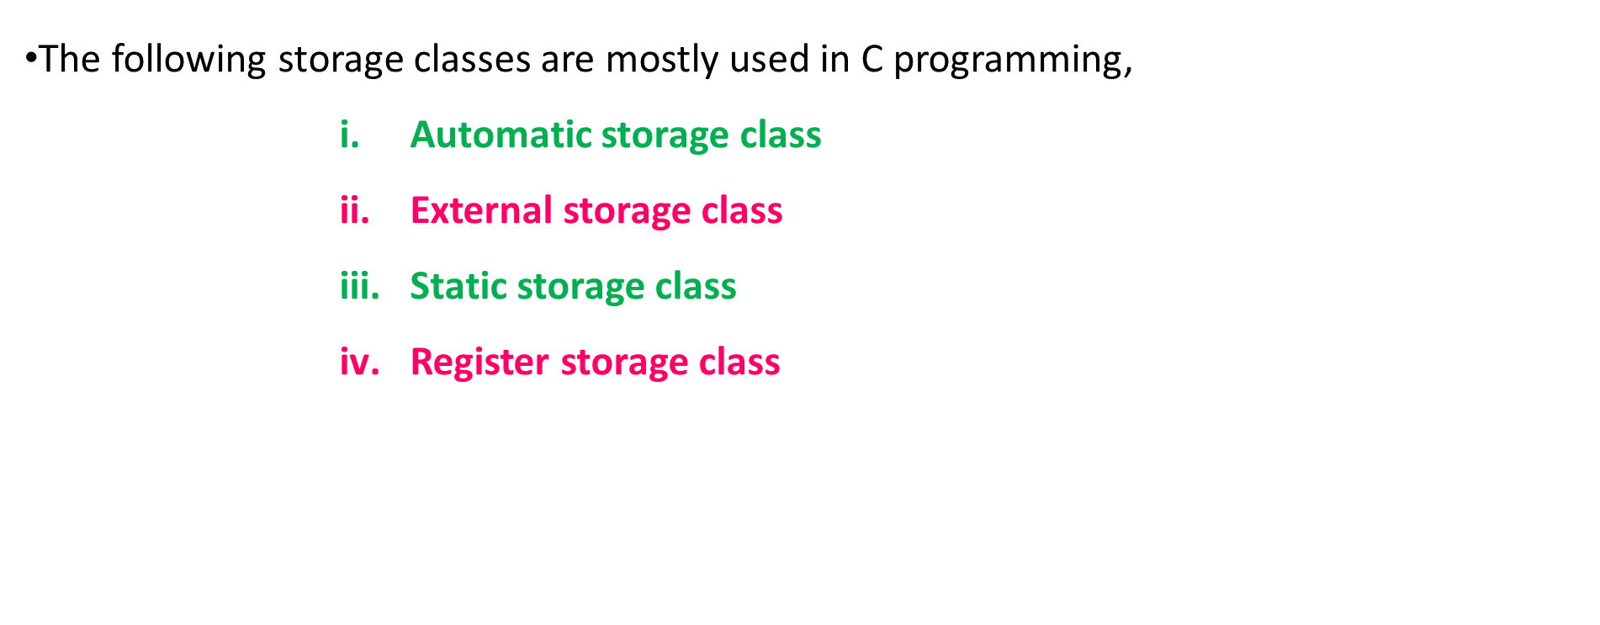
Storage Classes in C

Slide 33
1.Automatic storage class
A variable declared inside a function without any storage class specification, is by default an automatic variable
. They are created when a function is called and are destroyed automatically when the function's execution is completed.
Automatic variables can also be called local variables because they are local to a function
#include<stdio.h> void main() { int a; (or) auto int a;//Both are same } | int add( ) { int a=13; auto int b=48; return a+b; }
Syntax
auto data type variable name = value;

Slide 34
1.Automatic Storage class
Example 1: #include <stdio.h> void main( ) { auto int j = 1; { auto int j= 2; { auto int j = 3; printf ( " %d ", j); → 3 } printf ( "\t %d ",j); → 2 } printf( "%d\n", j); → 1 }

Slide 35
1.Automatic Storage class
Storage Classes : auto
Storage Place : RAM Memory
Initial Value/Default Value : Garbage Value
Scope : Local to block
Lifetime : Within the block

Slide 36
2.External storage class
A variable that is declared outside any function is a Global Variable.
Global variables remain available throughout the program execution.
One important thing to remember about global variable is that their values can be changed by any function in the program.
Syntax
extern data type variable name = value;

Slide 37
2.External storage class
Example for Global variable: #include<stdio.h> int num; // global variable void main() { num = 10; printf("in main function num value is %d \n", num); fun1(); fun2(); } Void fun1() { num = 20; printf(“ \n In fun1 num value is %d ", num); } voidfun2() { printf("\n In fun2 num value is %d", num); } Output: In main function num value is 10 In fun1 num value is 20 In fun2 num value is 20

Slide 38
2.External storage class
The extern keyword is used with a variable to inform the compiler that this variable is declared somewhere else.
Example 1: void main( ) { int x = 3; extern int y ; printf(" x = %d ", x); → 3 printf(" y = %d ", y); → 10 } y = 10 ; | Example 2: void fun( ); → function declaration extern int i = 1; → global variable declaration void main( ) { int i = 3; printf(" %d " , i); → 3 fun( ); } void fun( ) { printf(" %d ", i ); → 1 }

Slide 39
2.External storage class
Storage Classes : extern
Storage Place : RAM Memory
Initial Value/Default Value : zero
Scope : Global
Lifetime : Till the end of the program

Slide 40
3.Static storage class
A static variable tells the compiler to persist/save the variable until the end of program.
static variable is initialized only once and remains into existence till the end of the program.
Default value is 0 (zero).
Syntax
static data type variable name = value;

Slide 41
3.Static storage class
Using auto keyword | Using static keyword
#include<stdio.h> void test(); void main() { test(); test(); test(); } void test() { auto int a = 0; a = a + 1; printf("%d ",a); } Output: 1 1 1 | #include<stdio.h> void test(); void main() { test(); test(); test(); } void test() { static int a = 0; a = a + 1; printf("%d ",a); } Output: 1 2 3

Slide 42
3.Static storage class
Storage Classes : static
Storage Place : RAM Memory
Initial Value/Default Value : Zero
Scope : Local to block
Lifetime : Till the end of the main program

Slide 43
4.Register variable
Register variables inform the compiler to store the variable in CPU register instead of memory.
Register variables have faster accessibility than a normal variable.
Generally, the frequently used variables are kept in registers.
But only a few variables can be placed inside registers.
Syntax
register data type variable name = value;

Slide 44
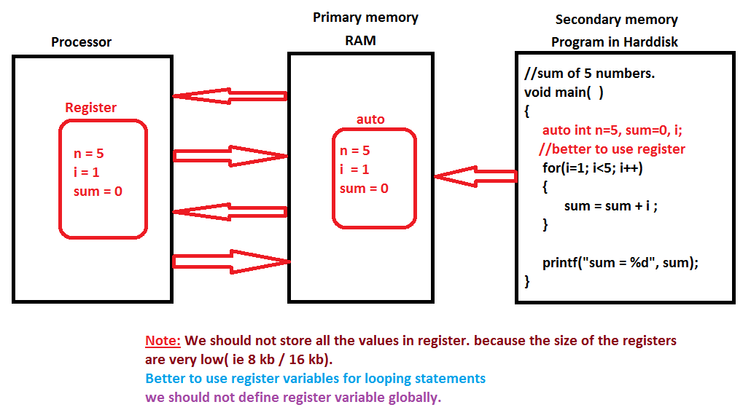
4.Register variable

Slide 45
4.Register variable
Storage Classes : register
Storage Place : register Memory
Initial Value/Default Value : Garbage Value
Scope : Local to block
Lifetime : Within the block

Slide 46

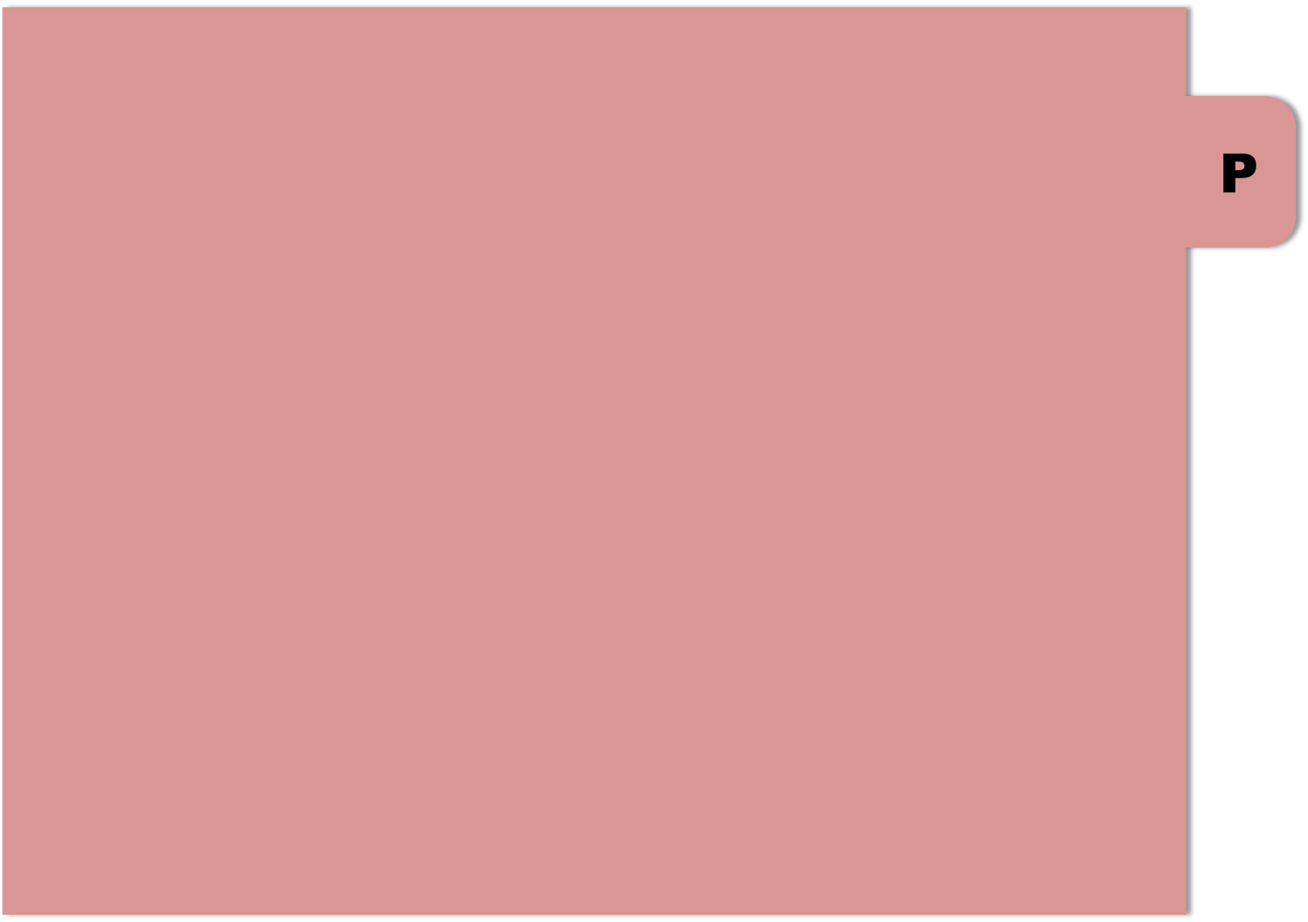

THANK YOU

